Slide 1


投資組合
Paul Dai
2023年7月
Notes:
Before we start, I want to thank you (all) for being here.
It’s my pleasure to introduce myself to you.

Slide 2
內容
項目2- Cyclistic自行車數據分析
項目3-數字營銷KPI追踪儀表板
自我介紹
1
項目1-LLM申請-自動查詢助手
2
項目2-時間序列模型-每日銷售預測
3
項目 3-AB 測試-購買卡
4
項目4-Google數據分析- Cyclistic自行車
5
許可證和獎項
6
Notes:
I’ll present for 20 mins:
First part, it’s about my background
The second part we have some project demos.
Because the limitation of our time, I think you could choose 1 or 2 case, and I’ll present that to you.
So, let me quickly go through all of them.
The 1st one is an AI model, going to predict the daily sales
The 2nd is data analysis case study, trying to find marketing strategies to enhance their members
3rd is an dashboard project, how I used AWS architecture to build dashboard.
4th is an expense reimbursements application system, that is a case I used VBA, SQL to help a start-up to build their expense application system.
Last one is an digital transformation strategies alignment, we helped a company to figure out their digital transformation blueprint.
So which one are you interested in?

Slide 3
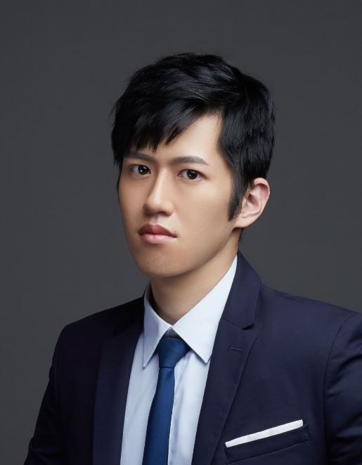

保羅戴，高級數據分析師 Sr. Data Analyst
工作經驗（6年+）
技能
CTW 公司（東京） 高級數據分析師
2023-現在
報告自動化 (VBA)
數據庫和SQL
通過轉換器模型建立了禮品推薦系統，每天賺取350k JPY。
KPMG 數位轉型諮詢 助理經理
ML
2020-2023
數據 分析
數據 視覺化
領導負責財富500強企業的數字轉型項目的開發和執行。
應用人物分群、數據分析在各種項目上，以提供執行報告。
語言
名字:
Neogence化妝品和護膚品 總經理特別助理
保羅戴
中文（母语）
英语（TOEIC 890）
日语（JLPT N2）
2017-2020
協助總經理和領導團隊通過數據分析和建模制定行動計劃。
帶領一個由初級助理組成的團隊，優化和自動化每個部門的流程。
申請職位：
數據科學家
教育
KMC Chain IND. CO., LTD (深圳) 管理助理
2014-2017
國立臺灣師範大學MBA
2010-2014 人力資源管理系，國立臺灣師範大學 Taiwan Normal University
聯繫方式：
手機：+81-80-6080-5242
2017
建立了跨職能部門的報告，以監控進度表現。
電子郵件：paul60209@gmail.com
Notes:
I believe that I am the best candidate for this position because an excellent Data Analyst needs not only hard skills,
but also have to know how to communicate cross-dep., how to lead or encourage your team members.
During my 6 years work experiences, I started from being a MA at KMC Chain, I rotated in different dep. and work with them.
That helped me to know each dep.’s culture and what’s they desire. And, that’s my first time working in China, at 深圳.
Bcz of the health issue of my family, I went back to 台灣 after a half year. That was the second stage of my career path.
I was the special assistant to GM in the company called “Neogence”. It’s a company which dedicates to skincare and makeup market. Neogence has a self-own brand and a factory.
It’s a 7 years start-up, yearly Rev. is about 1 billion NT dollars.
My first job was to restructure the ERP system and to repair the database.
I re-defined the principle of product ID and mapped the old product ID to the new one in the database.
Next, I developed automatic program to help our colleague to key-in purchase/selling order into ERP system more efficiently.
After a year, I was promoted to “Section Chief of GMO”. I started to build my own team.
There were 3 members in my team. We built an expense application system, imported the BI tool (Qlik Sense) to establish the visualized dashboards.
I started to train my soft skills, like… divide the project scope, track timeline, ensure everyone is clear about the project purpose, and how to review each member’s performance. My team achieved many huge projects perfectly during the period.
In 2020, I was seeking for a boarder stage and wanted to work aboard but because of COVID-19, it’s risky.
Thanks for the hunter who is my friend now, he referred me to KPMG as the assistant manager of the digital transformation consulting dep.
In KPMG, I engaged in more then 10 projects as project manager (PM).
I focus on digital transformation project, which include data analysis(TA persona tagging),
dashboard building (marketing campaign dashboard),
data modeling(used car residual value prediction),
process optimization (material requirement planning)
and strategies alignment(planning the blue print of digital transformation).
About the skills:
I’m good at VBA, which is for report automation and I’m also familiar with DB and SQL. Fourth more, I have experience of data analysis and machine learning (which I will demo later.)
I’m a Chinese native speaker. Although my English is not really fluent but I’m working on improving my English and I think I could handle daily conversation with no problem.
I just passed JLPT N2 this year. If there is any occasion that needs Japanese, the company could make good use of my skill.

Slide 4

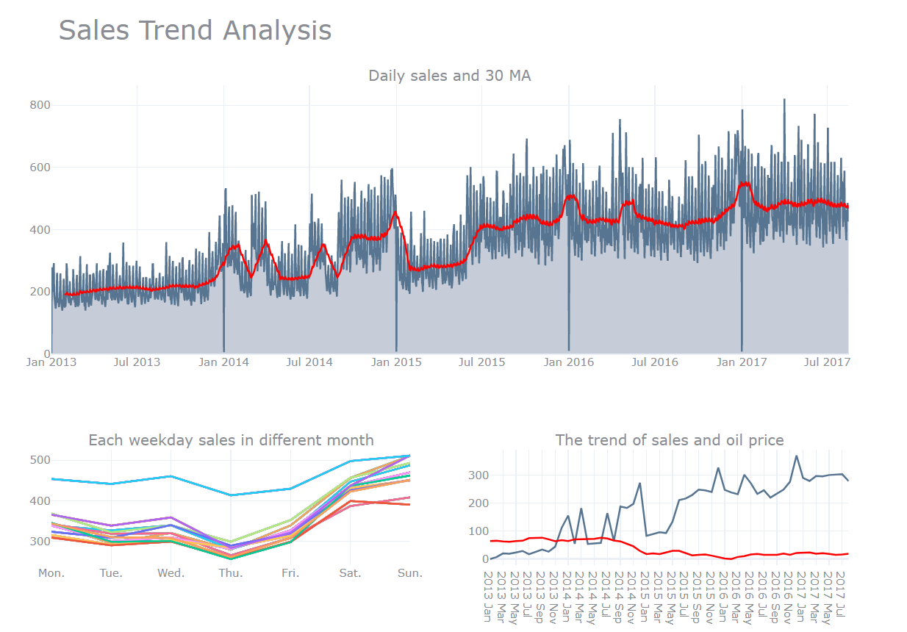

銷售趨勢分析
趨勢分析
發現：
銷售趨勢持續增加。
每年1月1日的銷售^{st}為0。
週末的銷售顯然比平日高。我們將在後續使用它作為外生變數。12月的銷售總是比其他月份高。
Sales in Dec. always higher than other months.
Notes:
I also made some dashboard to figure out weather is the trend or seasonal effect in our data.
There are some interesting findings.
Start from the top middle figure: It shows our sales is increasing, which means there is a trend in our data.
And, the sales on the 1st day of each year is 0.
Next, if you see the figure here, you will find sales on weekend is always higher than weekdays.

